Slide 1
Web Scrap
web scrapping & word frequency
Nexthike project
By: Garima choraria

Slide 2
Introduction
The project is about web scrap from http://python.org and to calculate the word frequency. The purpose of this is to understand how to scrap details from website and to find the word frequency.
In this project we also learned how to create a text file and to write the output into text file.
Web scrapping is used for analysis, research the important detail from websites. Web scrapping is highly used in business for gathering information about products, price and making strategies.

Slide 3
Objectives
To understand how to scrap the details in form of text from website using important libraries and how to use “url”.
Creating a text file
Calculating word frequency by converting text in same case(lower or upper case) removing unnecessary space and punctuation from text

Slide 4
Library
For scrapping and calculating word frequency we need to import some useful libraries like:
Requests library
From bs4 imported Beautifulsoup library
String library

Slide 5
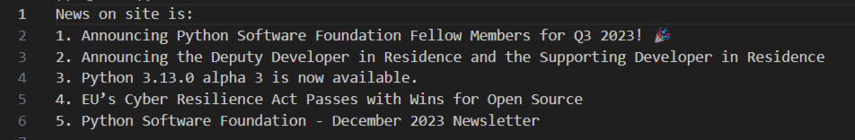
Result of Web Scrapping
Latest news were scrapped from python.org site by using requests and beautifulsoup library.

Slide 6
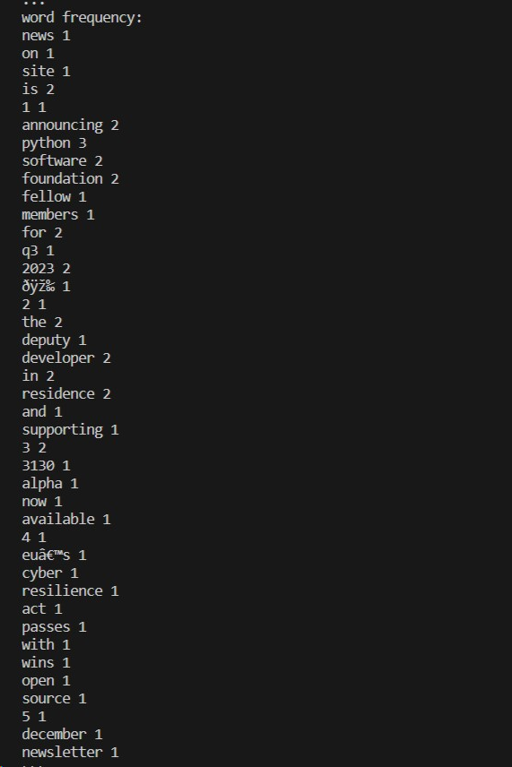
Total Word Frequency is
Total frequency is calculated which shows the weightage of each single word in scrap data.

Slide 7
Conclusion
The project is about web scrapping and calculating word frequency.
Converted outcome of scrapping into text file.
How to apply index, remove punctuation from words and counting text.

Slide 8
Thank you

